Slide 1



Navigating the Job Market: Top Hiring Trends for Fresh Graduates in Cyber Security
Group
4

Slide 2
Our team members and their roles
ABDULELAH HUSSEIN ABDULRAHMAN AL-KAF - TECHNICIAN
ABDUL RAHMAN AWADH MASOUD - USHER
ABDULRAHMAN GAMIL MOHAMMED AHMED - EDITOR
AMEERA ABDUL SATHAR - LEADER
ANAS ABDO AHMED THABIT - PHOTOGRAPHER
CATHLEEN MAYLA AATHIFAH ARDA - SECRETARY
HAZIQ IRFAN BIN RADZALI - COMMUNICATION

Slide 3
Our team members and their roles
JAMBULOV TIMUR - MODERATOR
KHALED FOSTOK - MODERATOR
KOSHEKOV TIMUR - EDITOR
MUHAMAD AHMAD AL MUHDAR - TECHNICAL ASSISTANCE
OGAY YURIY - GRAPHIC DESIGN
SAGYNDYK DIMASH - PHOTOGRAPHER
SAMEEHA SULAIMAN - GRAPHIC DESIGN

Slide 4


COMPANY BACKGROUND
AEON Bank, launched on May 26, 2024, is Malaysia's first Islamic digital bank, demonstrating its commitment to Shariah-compliant financial services and increasing financial inclusivity. AEON Bank is owned by AEON Financial Service Co., Ltd. and AEON Credit Service Berhad, subsidiaries of the Japanese conglomerate AEON Group. AEON Group, which began in 1758, has expanded into shopping malls, supermarkets, and financial services, with a consolidated operating revenue of ¥9 trillion.

Slide 5
FOUNDATIONAL IDEALS OF AEON BANK
AEON's philosophies emphasize peace, respect for humanity, and community contributions. The company views retail as a sign of peace and strives to make local communities stable and resilient. AEON respects individuality and autonomy, promoting personal growth through work and learning. It is committed to supporting regional richness and good living by meeting the needs of each community through product and service development. These underlying philosophies drive innovation, transformation, and a commitment to integrity and customer focus. Working and living AEON means serving peace, humanity, and local communities through business, always focusing on customers as the core of every activity.

Slide 6

PRODUCTS AND SERVICES
AEON Bank offers a range of digital banking products, including Savings Account-i, customizable Savings Pots, and advanced budgeting tools. It also issues both virtual and physical Visa Debit Cards-i. The bank's strong point is the AEON Points Programme, which links transactions with point earning facilities. Digital innovation is a priority, with new customers receiving a virtual card upon account activation. AEON Bank also participates in nationwide roadshows and community engagement activities.

Slide 7


ROLE AND RESPONSIBILITIES OF THE GUEST SPEAKERS:
LOW HUEY JUING & KAREENA KAUR
Aeon Bank's Chief Human Resource Officer, Kareena Kaur, and Senior Manager of Talent Management & Development, Low Huey Juing, shared their expertise in managing a modern workforce. Juing's responsibilities include finding and developing high-potential personnel, implementing training initiatives, managing performance reviews, succession planning, and career development. Kaur's role is to connect HR strategy with business goals, manage talent acquisition and retention, and focus on leadership development. Both leaders are committed to advancing inclusion, diversity, and HR technologies.

Slide 8
4 Hiring trends
FOCUS ON TECH-ENGINEERING
1
3
INCREASING SCOPE IN CYBERSECURITY
MARKET UNDERSTANDING AND COMMUNICATION SKILLS
MULTI-SKILLED PEOPLE FROM VARIOUS BACKGROUNDS
2
4

Slide 9
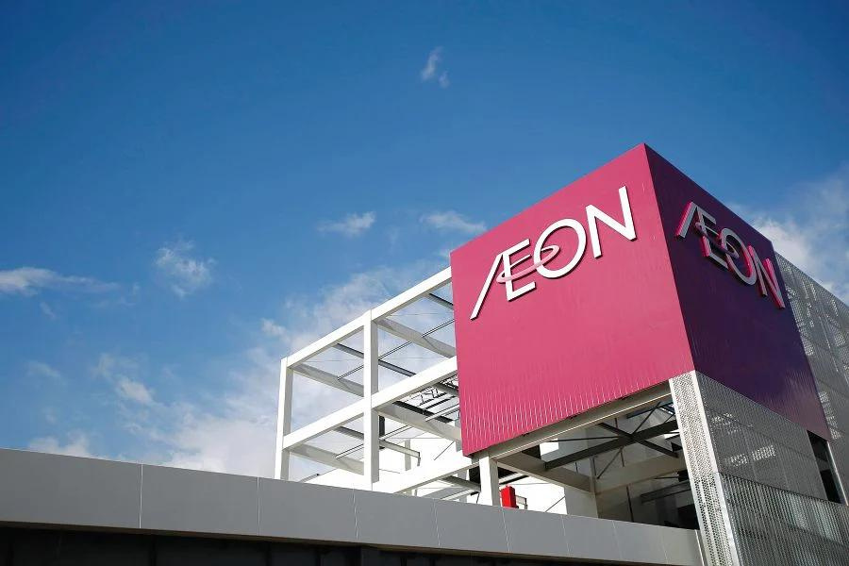
Interview Processes
Both hard and soft abilities are extensively assessed during the interview process at AEON Bank. In technical interviews, candidates must solve real-world problems, create systems, and solve coding difficulties; in behavioural interviews, candidates are asked situational questions to gauge cultural fit. A thorough assessment of candidates is ensured by cross-departmental panel interviews. Success requires practice, adequate dress, and preparation.

Slide 10

OUTCOMES AND ANALYSIS OF THE EVENT
Key Outcomes from the Talk Session
Part I
Enhanced Understanding of Cybersecurity Challenges
Participants learned about the difficulties that digital banks such as AEON confront in terms of cybersecurity and how important it is to both preventing security lapses and preserving financial stability.
Improved Interview Preparation
Participants learned about AEON's interview processes, emphasizing clear communication, honesty, and practical contributions, leaving them better equipped for job applications and interviews.

Slide 11

Key Outcomes
Part II
Networking Opportunities
Students had the chance to network with professionals at the event, which helped them stay up to date on industry trends and practices by providing insightful advice as well as possible job offers, internships, and mentorship.
Awareness of Industry Hiring Trends
The discussion focused on the main hiring trends in the industry and emphasised the need for people with a variety of abilities and real-world experience who can balance technical know-how with commercial savvy.

Slide 12
Hiring trends critical analysis
1
Cybersecurity
The Journal of Cybersecurity stresses the need for skilled professionals and robust measures against complex threats, highlighted by the 2016 Bangladesh Bank heist. AEON Bank has since improved its security significantly.
2
Market understanding and communication skills
Ferguson (2020) highlights the need for skilled employees to bridge organizational competence and market conditions, exemplified by Apple's marketing-technical team synergy in successfully launching products like iPhones and Apple Watch.

Slide 13
Hiring trends critical analysis
3
Tech Engineering
Marinc (2015) emphasizes the critical role of technology in financial sector digitalization. Organizations embracing AI, blockchain, and cloud technologies enhance market efficiency and operations. JPMorgan Chase, a leader in this trend, invested over $11 billion in 2020, developing solutions like the COiN platform to improve contract management and customer service through machine learning.
4
Multi-skilled people from various backgrounds
Nweiser and Dajnoki (2022) emphasize that diverse skills foster innovation and resilience in organizations. Multi-skilled employees enhance business processes and adaptability in volatile environments. Google exemplifies this by recruiting multi-talented individuals, promoting learning and creativity, resulting in innovations like Google Maps and Google Assistant from multidisciplinary teams.

Slide 14
Conclusion
Our team worked hard and collaborated well, making the event a success. Everyone contributed, whether through technical support, ushering, photography, communication, or moderating discussions.
The AEON Bank talk session gave us useful insights into cybersecurity hiring trends and the skills needed for future professionals. Speakers helped connect our academic learning with real-world practices.
Key points included the high demand for cybersecurity professionals, the need for strong communication skills, and the importance of continuous learning and adaptability.

Slide 15
Thank
You

